Slide 1
Placement Management System
BY:- ERROR 201

Slide 2

Group Members:-
Rudra Chauhan - 202301173
Poorva Vaishnav - 202301179
Kartik Vyas - 202301003
Kasak Sutaria - 202301030

Slide 3
Problem - P2:DAIICT Placement Manager:
Develop a comprehensive Placement Manager system to streamline the placement process for the university. This system will record and manage all placement-related activities for each batch and program, including written tests, interviews, shortlisting, and job offers. Also, it can search for students placed in a specific company, batch-wise, location-wise, mean and median package, etc.
LINK TO VIDEO EXPLANATION OF CODE:-
https://drive.google.com/file/d/1mIZ8LCg5qg9Qhf4YHbEWgcuGzo9lEQ5c/view?usp=sharing

Slide 4
ALGORITHM
Declare a class named JobOfffer then declare variables privately namely ID, Name, Batch, Written Test Status, Interview status, Placed/not, Package.
Now implement a constructor, get set function, display_joboffers, change status in this file.
Company: Company name, Address, Hired Students, Criteria, No_of_Alumni,At_College, Getter Setter, Constructor.
Internship: Company name1, Company name2, Duration1, Duration2, type1, type2, Sr_no, Student name, Getter Setter, Constructor, Display Internship.
Placement: Average package, Highest Package, Rate of Placement, Appeared Students, Placed students, Getter Setter, Constructor, max_package, min_package, median_package.
Schedule: Student ID, Student Name, Company Name, Start Time, End Time, Date, Location, Getter Setter, Constructor, Display_schedule.
Student: Student ID, Student name, Year Of Placement, Program, CGPA, Email, Phone, Getter Setter, Constructor.
Past Details: Include library.h header file.Student ID, Student Name, Phone, Company Name, Branch, Year Of Placement, Salary, Getter Setter, Constructor, display_past_details,Tokenize_alumni, Past_mean, Past_median, Past_highest.
Read files: tokenize_student, tokenize_company, read file.
Display function: This function is created to display all different functions which are created.
Main Function: Declared variables and read the csv files.

Slide 5
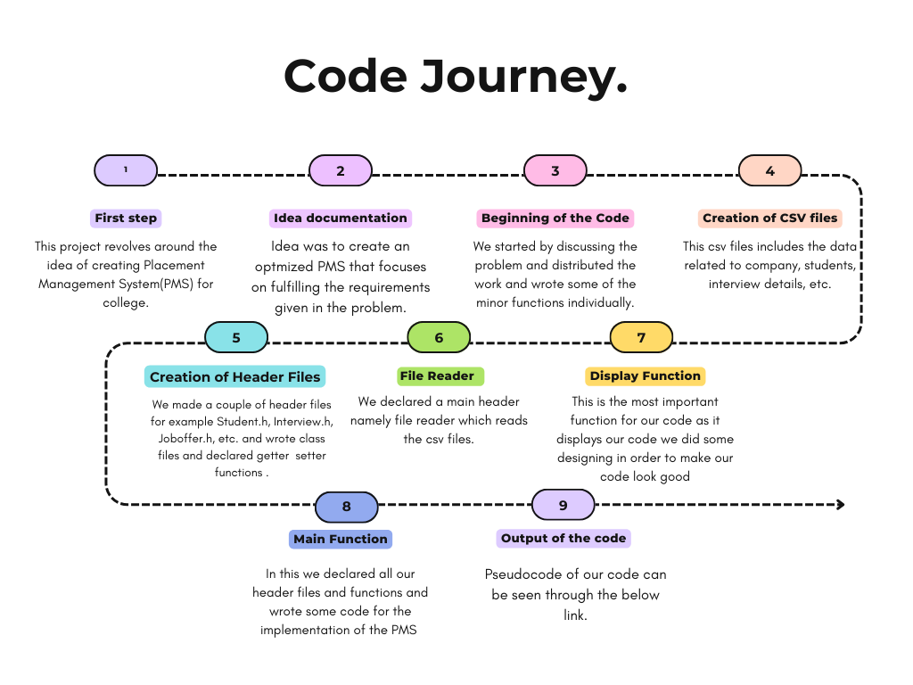
Pseudocode...

Slide 6
Time Complexity & Space complexity:
We will write Time & Space Complexity for every functions differently:
Display_joboffers: Time-O(1) & Space-O(m). Here m is the number of Strings taking entries from job offers headers.
Display_internship: Time-O(1) & Space-O(1).
Display_schedule: Time-O(1) & Space-O(n).
Display_particularstudent: Time-O(1) & Space-O(n).
Display_past_details: Time-O(n) & Space-O(mn). Here m is number of strings in each entries and n is space by map alumni.
Display_allstudents: Time-O(n) & Space-O(m).
Display_choice1: Time-O(1) & Space-O(1).
Display_allstudents: Time-O(n) & Space-O(m). Here m=entries in company vector with type company.
Display_choice2: Time-O(1) & Space-O(1).
Display_choice: Time-O(1) & Space-O(1).

Slide 7
Display: Time-O(1) & Space-O(1).
Max_package: Time-O(n) & Space-O(1).
Mean_package: Time-O(n) & Space-O(1).
Median_package: Time-O(n)+O(nlog(n))=O(n) {Here O(n) is for iteration and O(nlog(n)) for Sort function.} & Space-O(n).
Past_mean: Time-O(n) & Space-O(n).
Past_median: Time-O(n)+O(nlogn)=O(n) & Space-O(n).
Past_highest: Time-O(n) & Space-O(1).
Tokenize_alumni: Time-O(n) & Space-O(n).
Past_details: Time-O(mn)+O(nlog(n))=O(mn) {m=number of entries in file and n for all sizes.} & Space-O(n).
Tokenize_student: Time-O(n) & Space-O(n).
Tokenize_company: Time-O(n) & Space-O(n).
Tokenize_internship: Time-O(n) & Space-O(n).
Tokenize_schedule: Time-O(n) & Space-O(n).
Tokenize_joboffers: Time-O(n) & Space-O(n).
ead_file: Time-O(n) & Space-O(n).
Company_based_details: Time-O(n) & Space-O(kn).
Batchwise_placement_details: Time-O(n) & Space-O(kn).

Slide 8
THANK YOU

